Slide 1
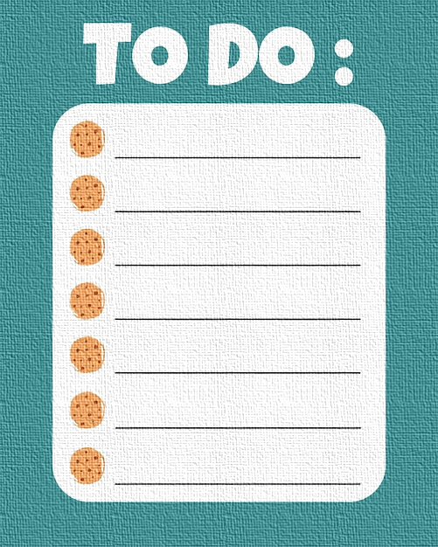
KEEPY-UPPY An Easy-To-Use Online To-Do List
By The Special Ones
​Anitej Mishra
Aryan Somanna
Kartikey Mishra
Vedant Pandey

Slide 2
CONTENTS
1
2
3
4
5
PROBLEM STATEMENT
OUR SOLUTION
SOFTWARE USED
CHALLENGES AND SOLUTIONS
RESULT

Slide 3
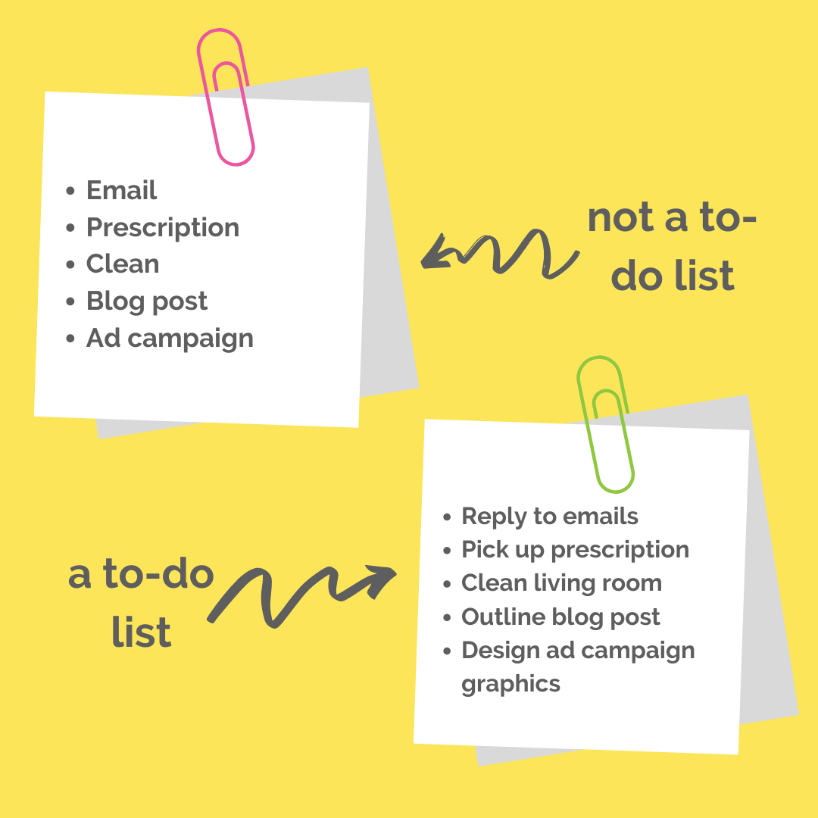
PROBLEM STATEMENT
PART 1

Slide 4
PROBLEM STATEMENT
Develop an intuitive, user-friendly online to-do list application that allows users to efficiently manage tasks.
The platform must support task creation, editing, deletion, and categorization, with features for setting deadlines and reminders.
Aim to enhance productivity by incorporating collaborative functionalities, enabling users to share tasks and progress updates with others.
Design in an appealing, user-friendly way that is easy to use and easy on the eye without hindering the core capabilities of the application.

Slide 5
OUR SOLUTION
PART 2

Slide 6
OUR SOLUTION
We have written a CSS code that is designed to style the web page with a responsive layout that adapts to different screen sizes, focusing on a light color scheme (during the programming phase we have a high contrast theme for clarity, namely black, white, and red) and a grid layout for organizing content. Here's a brief explanation of its key components:
Global Styles: Sets the background color to black, text color to white, and the default font to Arial, Helvetica, or Sans-serif at 15px size with a line height of 1.5. It also removes the default padding and margin from all elements.

Slide 7
OUR SOLUTION
Content Styles for Narrow Screens: Initially, the #content div uses a grid layout optimized for narrow screens. It defines a template with areas for a header, navigation (nav), main content sections, an aside (sidebar), and a footer, each spanning across the full available width.
Responsive Image Adjustment: For narrow screens (max-width: 760px), section images are centered and resized to fit the screen width, ensuring the layout remains visually appealing on smaller devices.

Slide 8
OUR SOLUTION
Specific Section Styles: Each section of the page (header, nav, main, section, aside, footer) is given unique styling attributes. This includes text alignment, padding, background colors, and border styles to ensure each section is visually distinct and aligned with the overall design theme.
Accessibility and Usability Enhancements: The use of list-style-type: none for unordered lists and specific styling for links and buttons enhances the visual clarity and usability of the page's interactive elements. The main content area and images within it are designed to fit the screen appropriately, using object-fit for images to maintain their aspect ratio and coverage.

Slide 9
OUR SOLUTION
Overall, the CSS code demonstrates a comprehensive approach to creating a responsive, visually engaging web page layout that prioritizes clear navigation, distinct sectioning, and a cohesive color scheme to enhance user experience across various devices.

Slide 10
SOFTWARE USED
PART 3

Slide 11








SOFTWARE USED
HTML
CSS
JavaScript
VISUAL STUDIO CODE
For creating the web pages
For designing the web-pages
A driver code
IDE
BRAVE BROWSER
GOOGLE CHROME
MICROSOFT EDGE
JOSE MOURINHO
To run the HTML Code
An alternative for Brave
Another alternative for Brave
The Special One

Slide 12
CHALLENGES AND SOLUTIONS
PART 4

Slide 13
CHALLENGES & SOLUTIONS
Cross-browser compatibility: Different browsers may interpret HTML, CSS, and JavaScript codes differently. We tested our to-do list application across multiple browsers (e.g., Chrome, Firefox, Safari, Edge) which is essential to ensure consistent functionality and appearance.
Responsive design: Ensuring that our to-do list looks and functions well on different devices and screen sizes (e.g., desktops, laptops, tablets, smartphones) is important. Implementing responsive design techniques using CSS media queries helped us adapt our layout for various devices.

Slide 14
CHALLENGES & SOLUTIONS
Data persistence: To make our to-do list to retain tasks even after the user closes the browser or refreshes the page, we needed to implement data persistence. We achieved this using techniques such as local storage, cookies. Another alternative for this is to integrate with a backend server and database.
Accessibility: We had to make sure that our to-do list is accessible to users with disabilities. This involves using semantic HTML markup, providing alternative text for images, ensuring keyboard navigation is possible, and testing with assistive technologies like screen readers.

Slide 15
CHALLENGES & SOLUTIONS
Performance optimization: Optimizing any code for performance can improve the user experience, especially for larger to-do lists or users with slower internet connections. “Minifying” and compress the CSS and JavaScript files, optimizing images, and considering lazy loading resources helped us to reduce initial load times.
User experience (UX) design: Designing an intuitive and user-friendly interface is key to the success for any good application. We considered factors such as layout, colour scheme, typography, and an interactive design to create a positive user experience.

Slide 16
CHALLENGES & SOLUTIONS
Testing and debugging: Thoroughly testing a code/program for bugs and issues is essential. We used built-in browser developer tools for debugging JavaScript and CSS. We also considered implementing automated testing frameworks for more comprehensive testing coverage.

Slide 17
RESULTS AND WORKING OF THE PROJECT
PART 5

Slide 18
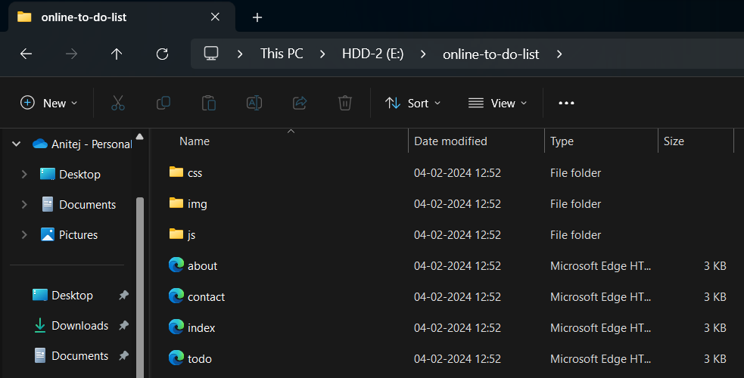
RESULTS & WORKING
The Contents of the Folder
Files to be Used
home.css
about.css
todostyle.css
Some Images for Looks & Feels
app.js
about.html
contact.html
index.html (Initial State & Home Page)
todo.html

Slide 19
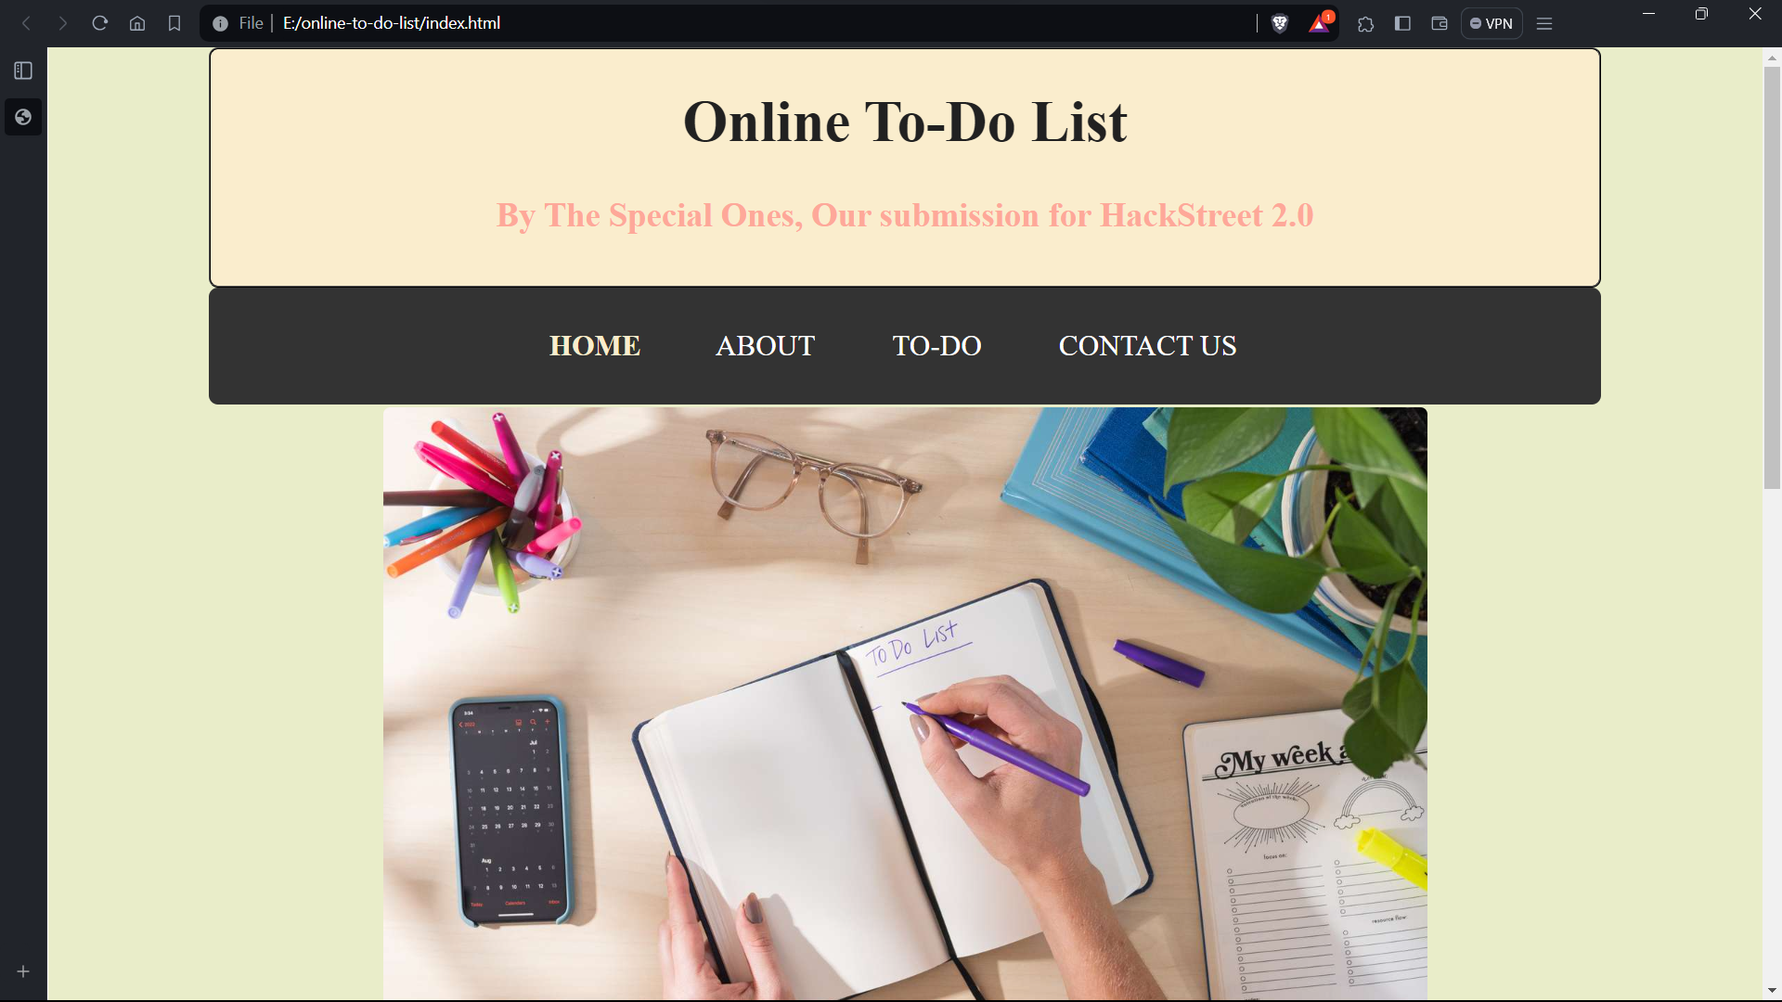
RESULTS & WORKING
Open the index.html file in a browser, this opens the home page of the Online To-Do List application.
Now the options are to stay on the home page, or go to the “Contact Us”, “About” or “To-Do” pages.

Slide 20
HOME PAGE

Slide 21
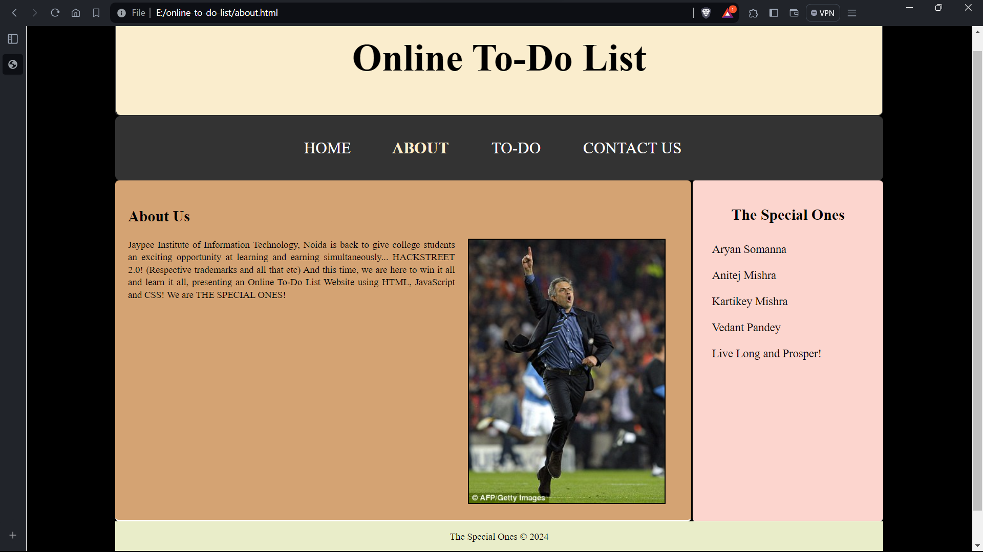
ABOUT PAGE

Slide 22
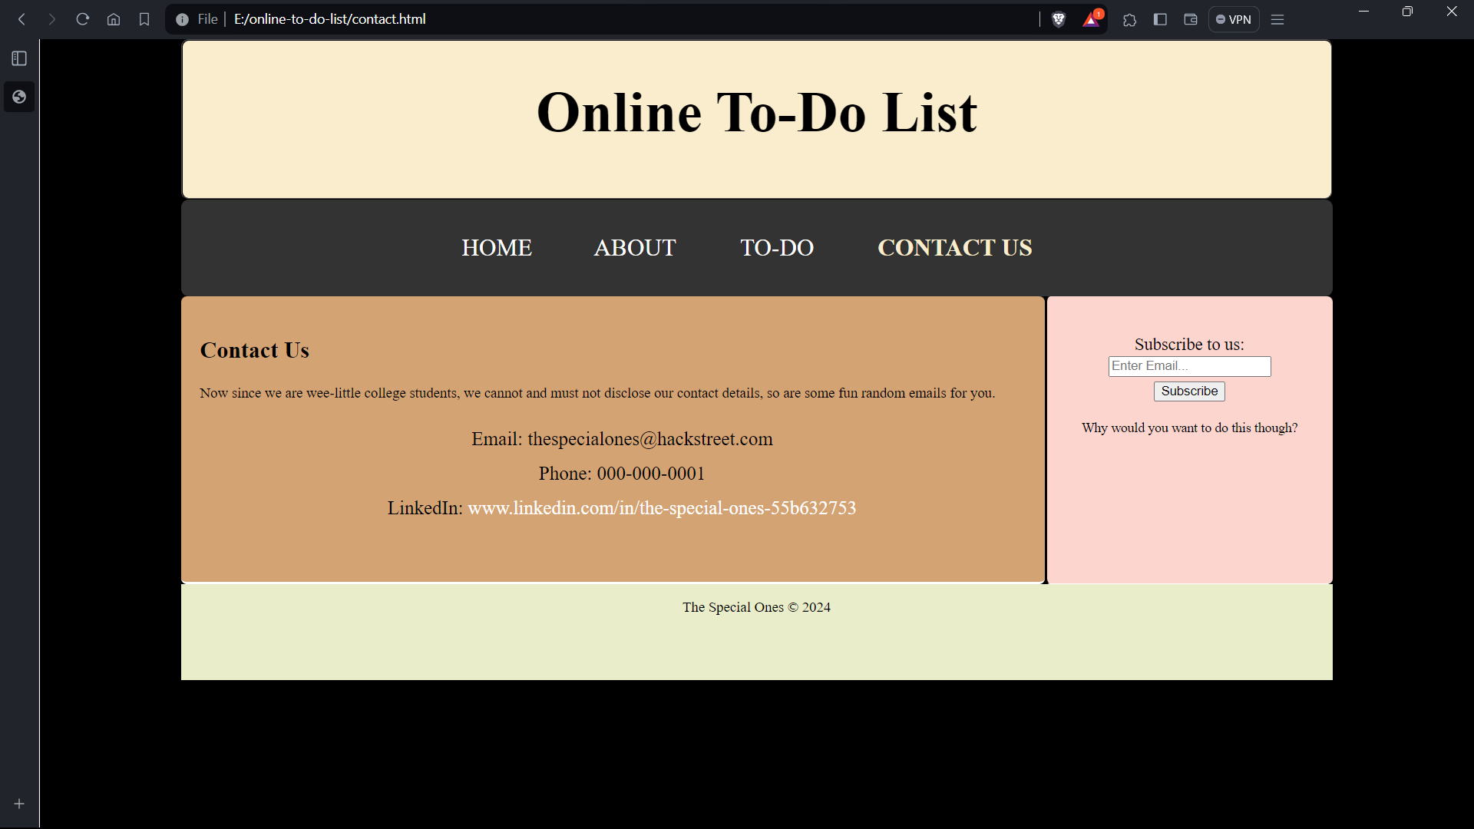
CONTACT US PAGE

Slide 23
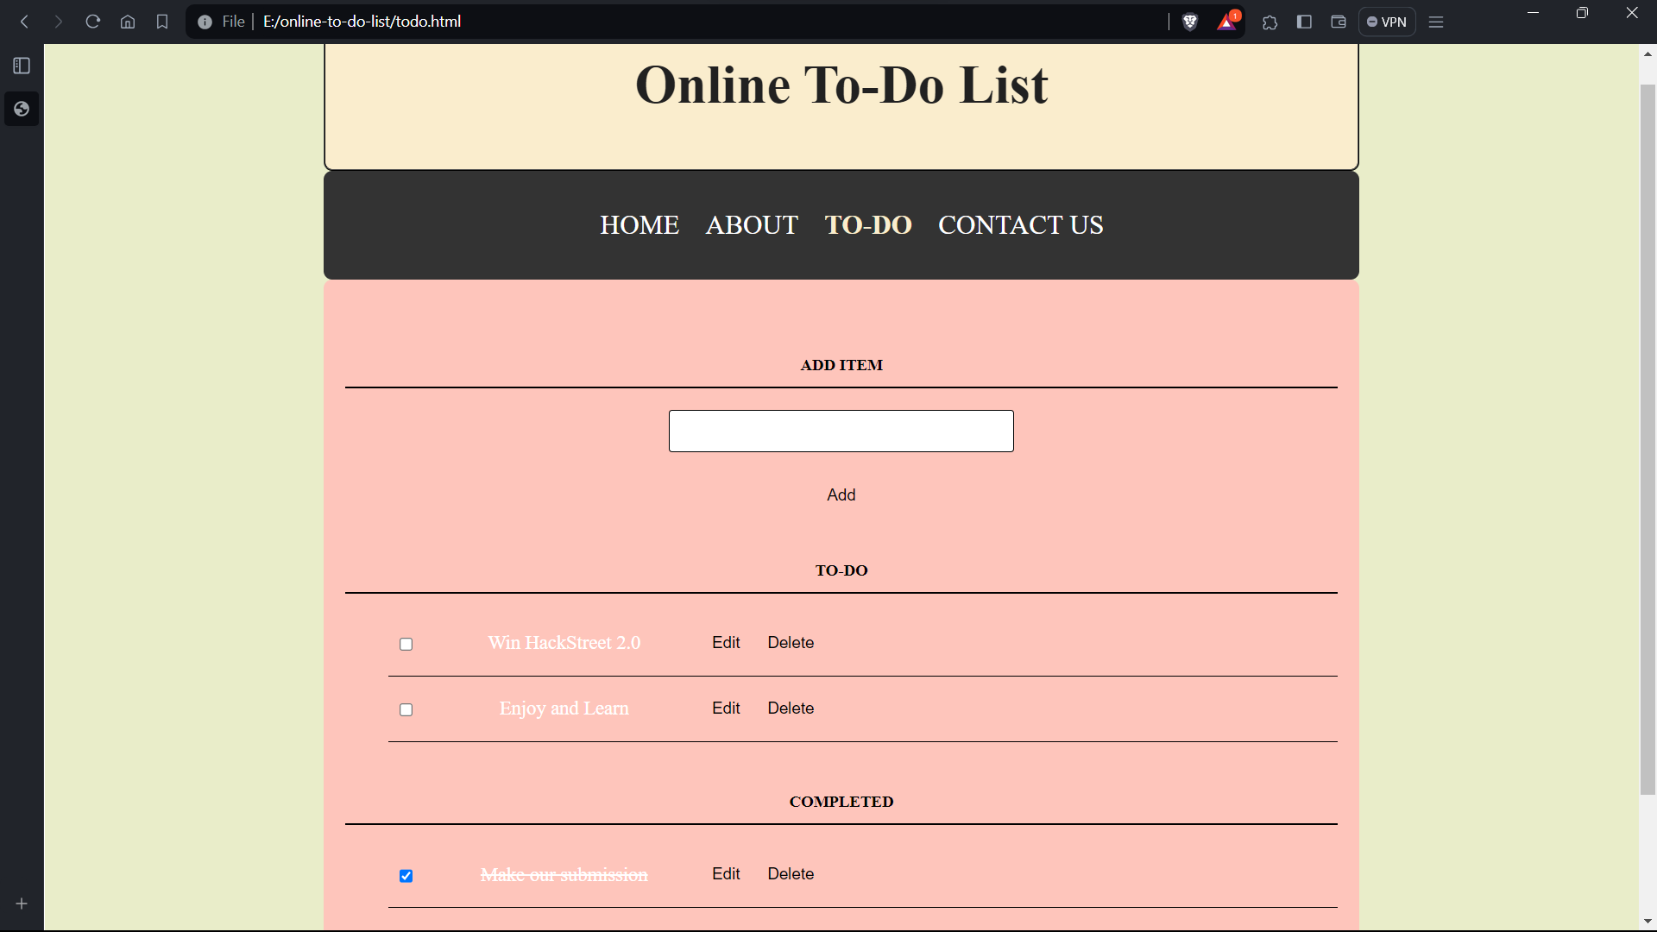
TO-DO PAGE

Slide 24
RESULTS & WORKING
On the To-Do Page, the user can add, edit and delete tasks or mark them as complete.
The tasks are categorized accordingly.
To add a task, the user can type the name of the task in the text box and press the button to add it, then the task will show up under the To-Do list.
To delete a task, they can simply press the delete button.

Slide 25

RESULTS & WORKING
The user can select the check box next to a task to mark it is as complete.
In that case the task will striked-through and it will show up under the completed list.
The user can uncheck the task to transfer it back to the to-do list.
To edit the task, the user can press the edit button and type the new name of the task.

Slide 26
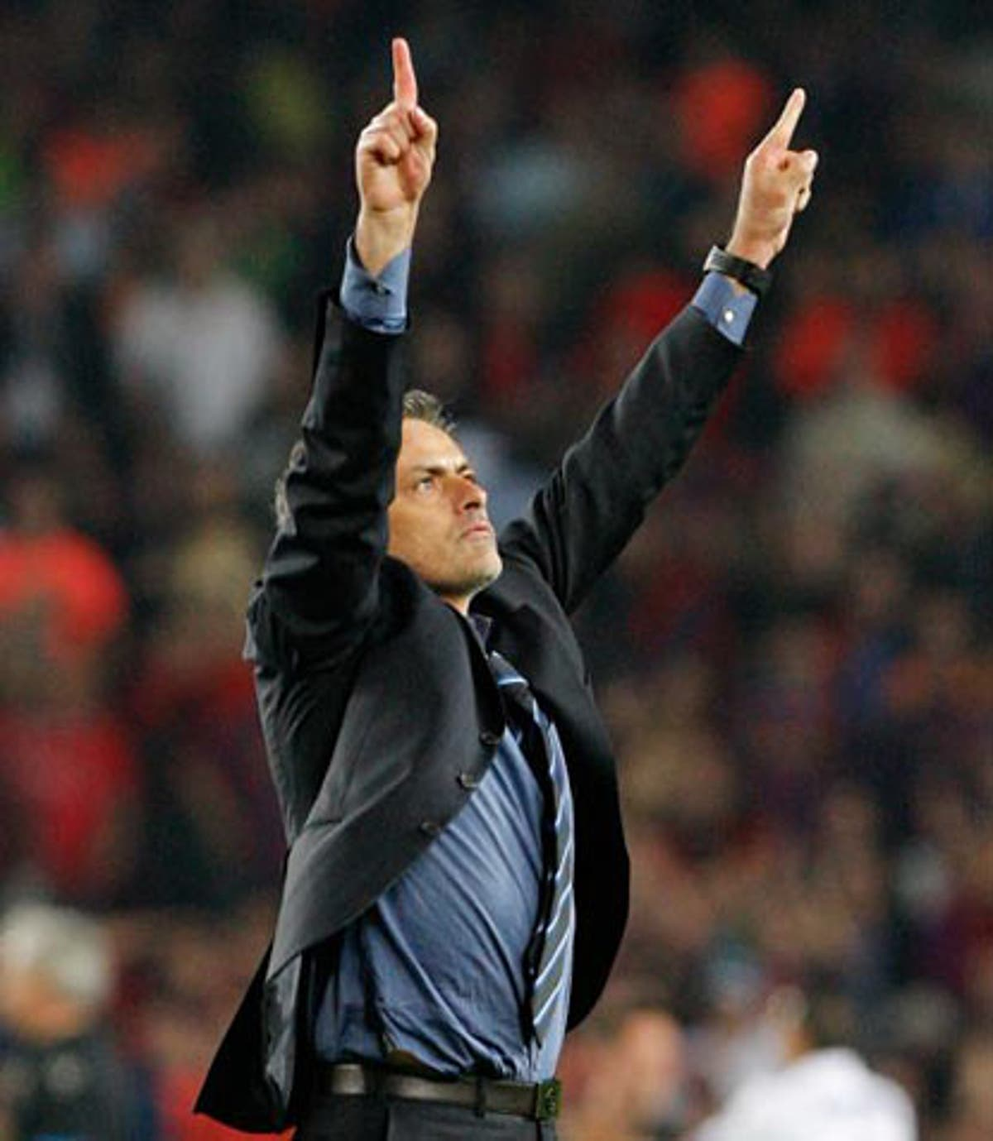
THANK YOU!
THE SPECIAL ONES
ANITEJ MISHRA
ARYAN SOMANNA
KARTIKEY MISHRA
VEDANT PANDEY

